Slide 1
ATAI
Advanced Techniqueof Artificial Intelligence
ATAI
ChongqingUniversity _{AdvancedTechniqueof}
of Technology Artificial Intelligence
Chongqing University of
Technology
Chongqing University ^{ATAI}
_{of Technology} Advanced Techniqueof
Artificial Intelligence
Chongqing University of Technology
Chongqing University of Technology
Select and Distill: Selective Dual-Teacher Knowledge Transfer for Continual Learning on Vision-Language Models
https://chuyu.org/research/snd
2025.2.17 •HeNan
—— ECCV_2024
Reported by Lele Ren
1

Slide 2
ATAI
AdvancedTechniqueof
Artificial Intelligence
ATAI
ChongqingUniversity _{AdvancedTechniqueof}
of Technology Artificial Intelligence
ChongqingUniversity of Technology
Motivation
The pre-trained Vision-Language Model (VLM) typically forgets previously learned knowledge when adapting to downstream task sequences, which leads to a decrease in zero-shot classification performance. Existing methods have not effectively addressed this issue. Therefore, this paper proposes a unique selective dual-teacher knowledge transfer framework.

Slide 3
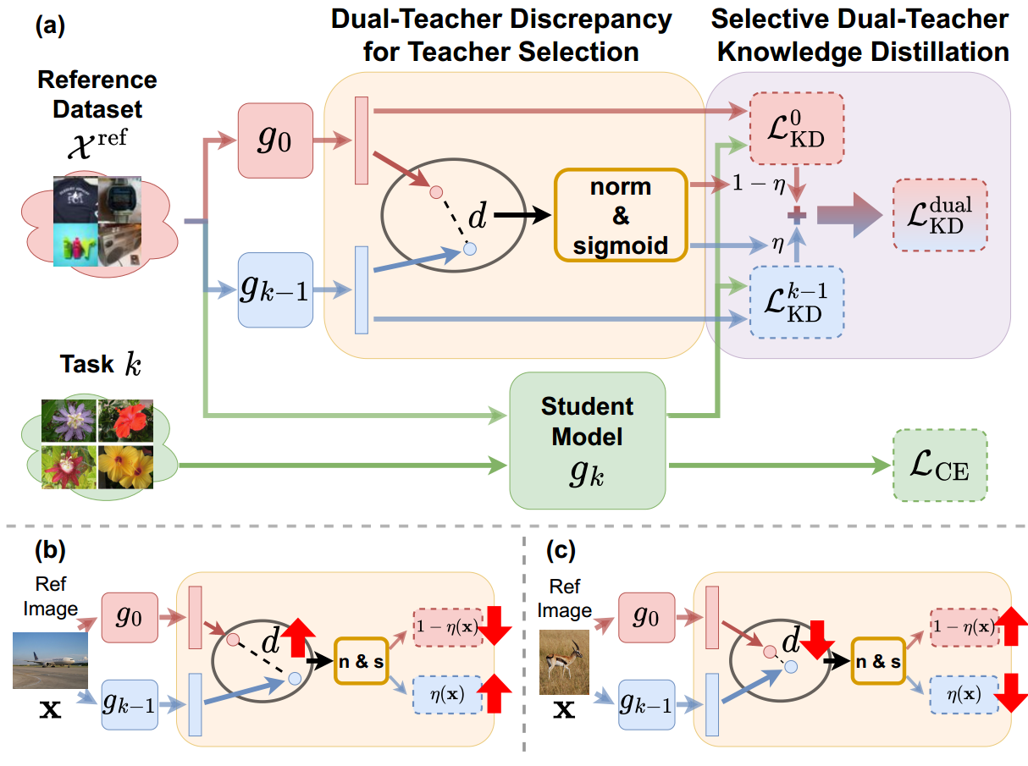
ChongqingUniversity of Technology
ATAI
AdvancedTechniqueof
Artificial Intelligence
ATAI
ChongqingUniversity _{AdvancedTechniqueof}
of Technology Artificial Intelligence
Overview

Slide 4
ChongqingUniversity of Technology
ATAI
AdvancedTechniqueof
Artificial Intelligence
ATAI
ChongqingUniversity _{AdvancedTechniqueof}
of Technology Artificial Intelligence
Method

Slide 5
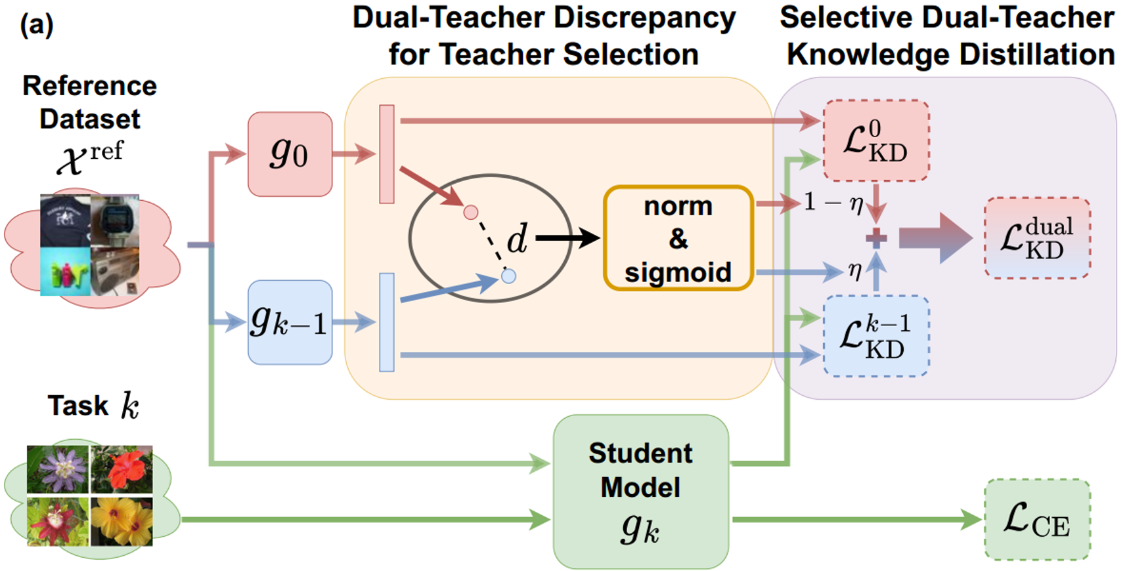
ChongqingUniversity of Technology
ATAI
AdvancedTechniqueof
Artificial Intelligence
ATAI
ChongqingUniversity _{AdvancedTechniqueof}
of Technology Artificial Intelligence
Method

Slide 6
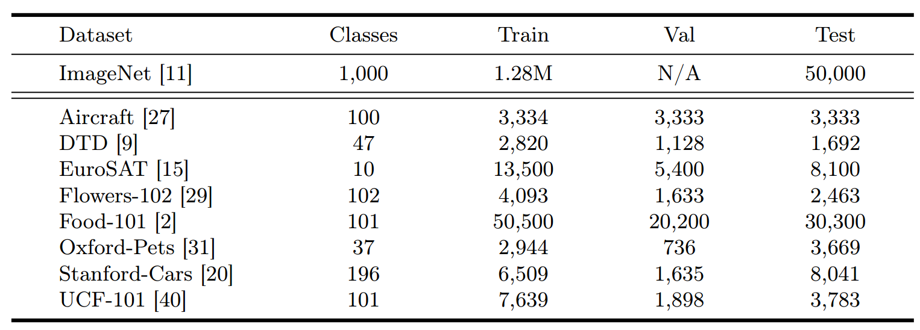
ATAI
AdvancedTechniqueof
Artificial Intelligence
ATAI
ChongqingUniversity _{AdvancedTechniqueof}
of Technology Artificial Intelligence
ChongqingUniversity of Technology
Experiments

Slide 7
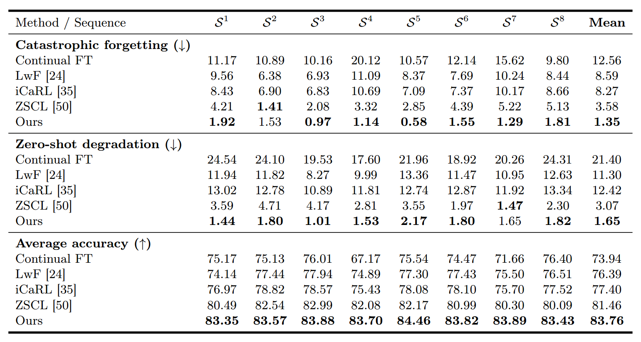
ATAI
AdvancedTechniqueof
Artificial Intelligence
ATAI
ChongqingUniversity _{AdvancedTechniqueof}
of Technology Artificial Intelligence
ChongqingUniversity of Technology
Experiments

Slide 8
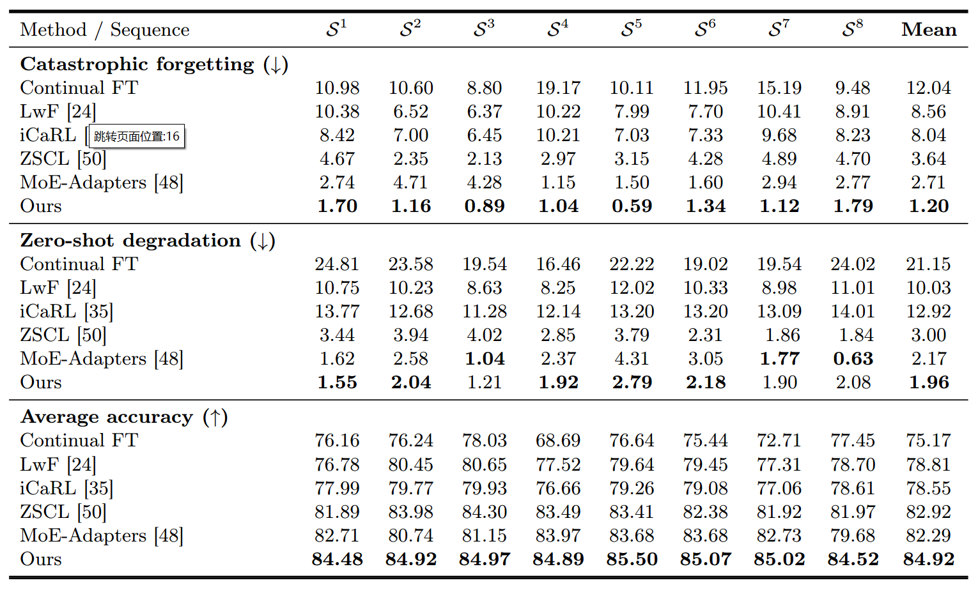
ATAI
AdvancedTechniqueof
Artificial Intelligence
ATAI
ChongqingUniversity _{AdvancedTechniqueof}
of Technology Artificial Intelligence
ChongqingUniversity of Technology
Experiments

Slide 9
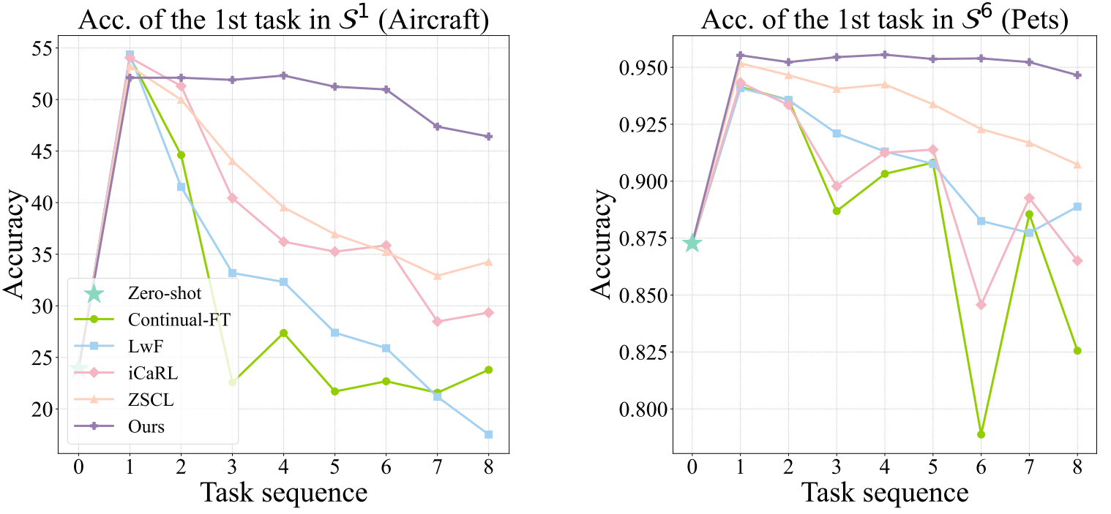
ATAI
AdvancedTechniqueof
Artificial Intelligence
ATAI
ChongqingUniversity _{AdvancedTechniqueof}
of Technology Artificial Intelligence
ChongqingUniversity of Technology
Experiments

Slide 10
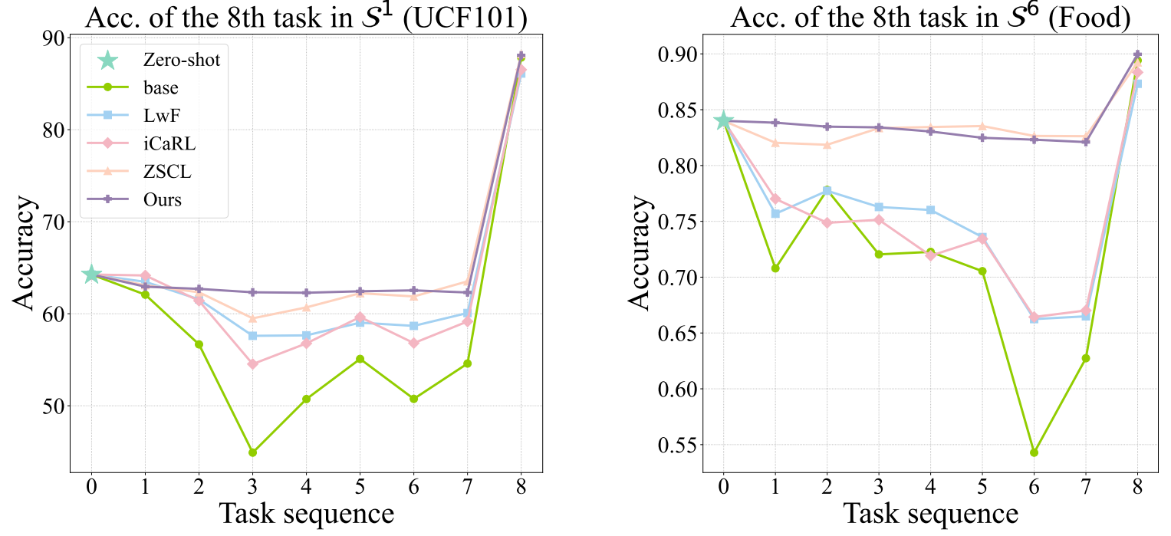
ATAI
AdvancedTechniqueof
Artificial Intelligence
ATAI
ChongqingUniversity _{AdvancedTechniqueof}
of Technology Artificial Intelligence
ChongqingUniversity of Technology
Experiments

Slide 11
ATAI
AdvancedTechniqueof
Artificial Intelligence
ATAI
ChongqingUniversity _{AdvancedTechniqueof}
of Technology Artificial Intelligence
ChongqingUniversity of Technology
Experiments

Slide 12
ChongqingUniversity of Technology
ATAI
AdvancedTechniqueof
Artificial Intelligence
ATAI
ChongqingUniversity _{AdvancedTechniqueof}
of Technology Artificial Intelligence
Thanks!

